Slide 1

Food Delivery Time Prediction
- Revathi Boopathi

Slide 2
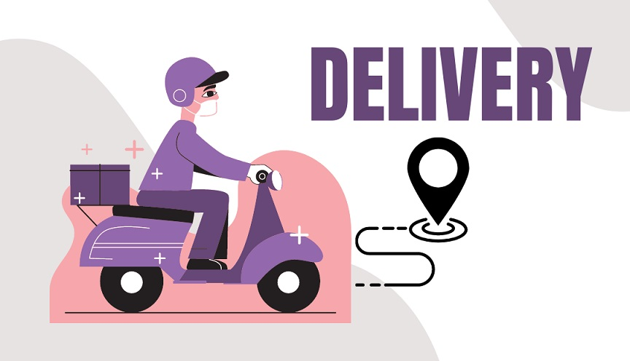
Agenda
1) Business Understanding
2) Data Understanding
3) Data Preparation
4) Modeling
5) Evaluation & Deployment
6) Future Scope

Slide 3


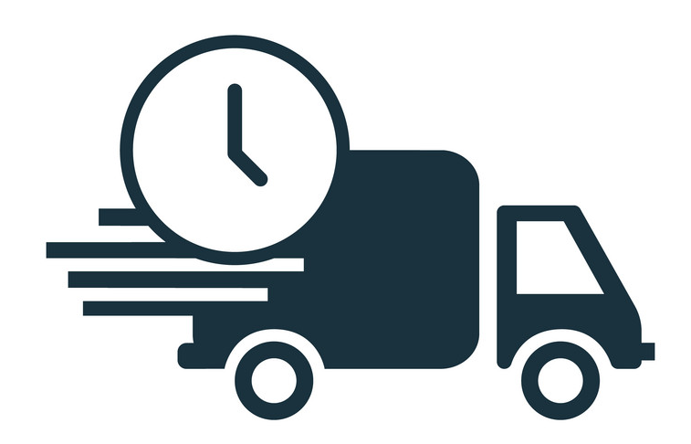



Objective:
Business Understanding
Data Understanding
Data Preparation
Modeling
Evaluation & Deployment
Delivery time prediction and root cause analysis for food delivery courier service
Motivation:
Enhanced user experience by minimizing delivery time
Potential Outcome
Optimal Driver experience
Optimal store logistics
Quick delivery
Enhanced shopper experience
Revenue growth for retailer
External factors

Slide 4
Business Questions
Business Understanding
Data Understanding
Data Preparation
Modeling
Evaluation & Deployment
Who is the target audience?
India
What factors can impact the delivery time?
Geographic factors
Time based attributes
Driver based attributes
External factors

Slide 5
Factors Influencing Delivery time:
Business Understanding
Data Understanding
Data Preparation
Modeling
Evaluation & Deployment
Geographic attributes:
Distance between restaurant & delivery spot
State
City type
Time based attributes
Order time
Day of order
Order pickup time
Driver based attributes
Type of vehicle
Multiple order handling
Driver ratings
Age
External attributes
Weather
Holiday

Slide 6
Business Understanding
Data Understanding
Data Preparation
Modeling
Evaluation & Deployment
Dataset:
Food delivery courier service data
Additional Info:
Contains majority details on factors discussed before
Link: https://www.kaggle.com/datasets/gauravmalik26/food-delivery-dataset?select=train.csv

Slide 7
Business Understanding
Data Understanding
Data Preparation
Modeling
Evaluation & Deployment
Geographic attributes:
Distance between restaurant & delivery location
State
City type
Time based attributes
Order time
Day of order
Order pickup time
Driver based attributes
Type of vehicle
Multiple order handling
Driver ratings
Age
External attributes
Weather
Holiday

Slide 8
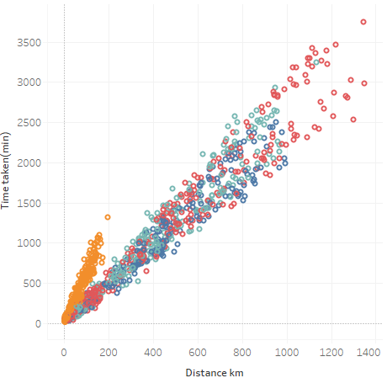
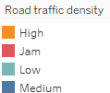
Business Understanding
Data Understanding
Data Preparation
Modeling
Evaluation & Deployment
Geographic Factors:
Relationship between Distance & time taken to deliver
Positive relationship exhibited between the 2 variables
When road traffic is high, even if distance is too low, the time for delivery is high

Slide 9
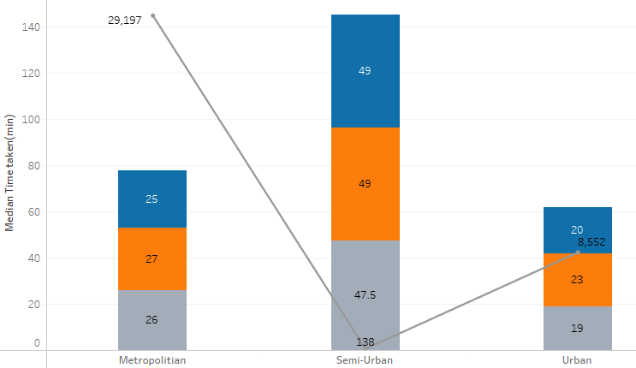

Business Understanding
Data Understanding
Data Preparation
Modeling
Evaluation & Deployment
Geographic Factors:
City type wise time to delivery and number of trips involved
Semi-urban delivery seems to take a lot of time compared to other areas
More trips observed in metropolitan areas and urban areas compared to very less trips in semi-urban areas

Slide 10
Business Understanding
Data Understanding
Data Preparation
Modeling
Evaluation & Deployment
Geographic attributes:
Distance between restaurant & delivery spot
State
City type
Time based attributes
Order time
Day of order
Order pickup time
Driver based attributes
Type of vehicle
Multiple order handling
Driver ratings
Age
External attributes
Weather
Holiday

Slide 11
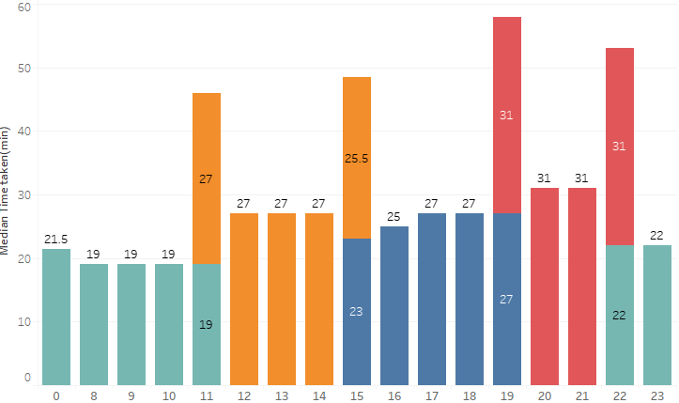
Business Understanding
Data Understanding
Data Preparation
Modeling
Evaluation & Deployment
Time to deliver across order hour of the day
High road traffic observed during afternoons and peak night hours leading to high median time for delivery

Slide 12
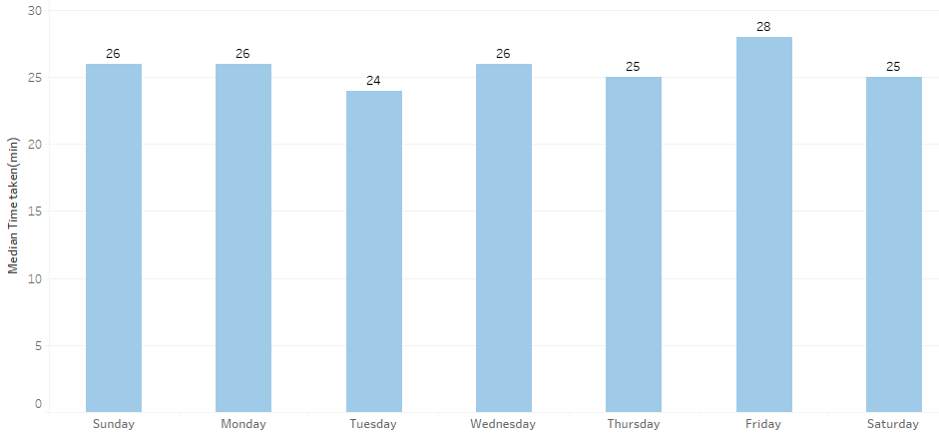
Business Understanding
Data Understanding
Data Preparation
Modeling
Evaluation & Deployment
Not a significant change in delivery time observed across various days of the week, there might be confounding factors
Time to deliver across days of the week

Slide 13
Business Understanding
Data Understanding
Data Preparation
Modeling
Evaluation & Deployment
Geographic attributes:
Distance between restaurant & delivery spot
State
City type
Time based attributes
Order time
Day of order
Order pickup time
Driver based attributes
Type of vehicle
Multiple order handling
Driver ratings
Age
External attributes
Weather
Holiday

Slide 14
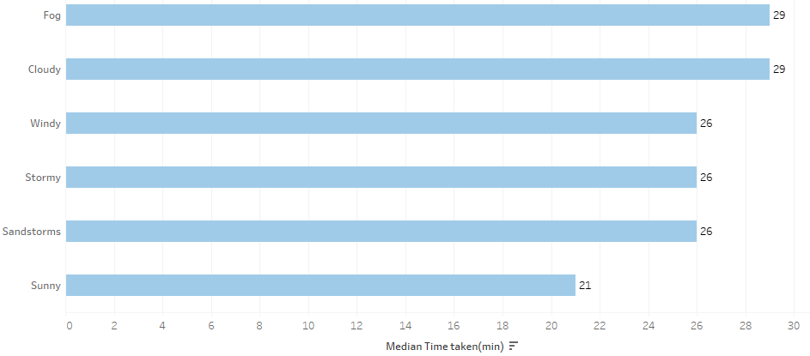
Business Understanding
Data Understanding
Data Preparation
Modeling
Evaluation & Deployment
Weather conditions like fog, cloudy state might be a crucial reason for high delivery time for a driver
Time taken to deliver across weather condition

Slide 15
Business Understanding
Data Understanding
Data Preparation
Modeling
Evaluation
Variable Importance Analysis
Univariate Variable Impact Analysis:
Categorical variables
One-way ANOVA
Numerical variables
Correlation (Pearson & Spearman)
Interacting Variable Impact Analysis:
Two-way ANOVA

Slide 16
Business Understanding
Data Understanding
Data Preparation
Modeling
Evaluation
Variable Encoding
Numerical predictors
Min max scaling (Rating, distance, etc.)
Categorical Predictors
Ordinal – Label Encoding
Nominal – One Hot Encoding (weather condition, festival, etc.)
Train test split
Random 60:20:20 train: validation: test split

Slide 17
Business Understanding
Data Understanding
Data Preparation
Modeling
Evaluation
Model Selection criteria:
Should be able to handle non-linear relationship between independent variables & target
Predicts numerical values
Should have factors that take care of multicollinearity amongst features
Model shortlisted:
XG Boost
Random Forest

Slide 18
Business Understanding
Data Understanding
Data Preparation
Modeling
Evaluation & Deployment
Model | Implementation Criteria | RMSE | N-RMSE * | MAPE
XG Boost | General | 9.6070 | 1.0362 | 34.8%
 | Dimensionality Reduction (PCA) | 9.3495 | 1.0085 | 35.04%
Random Forest | General | 9.4515 | 1.0195 | 34.48%
 | Dimensionality Reduction (PCA) | 9.3495 | 1.0085 | 35.04%
Regularization | Lasso | 9.2721 | 1.0001 | 33.90%
* N-RMSE: RMSE normalized by standard deviation of the distribution
The model is deployed using Streamlit
Lasso Regression seems to perform better amongst the shortlisted regression models

Slide 19

Next Steps
Modeling:
Implement stacked models and evaluate metrics
Include other critical features
Perform a robust feature selection
Business:
Explore root cause and prescriptive strategies post predicting delivery time

Slide 20

Thank You
Revathi Boopathi
revathi.boopathi@icloud.com
https://www.linkedin.com/in/revathi-boopathi-87153774/

